Slide 1
Abstract algebra ch 14 ideals and factor rings

Slide 2
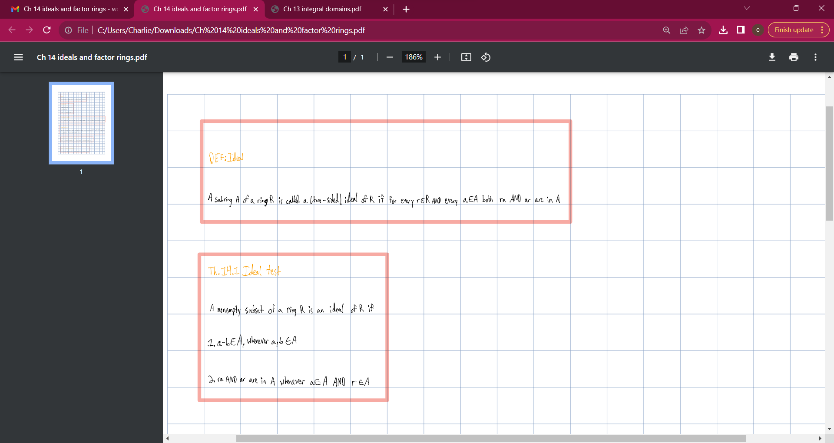

Slide 3
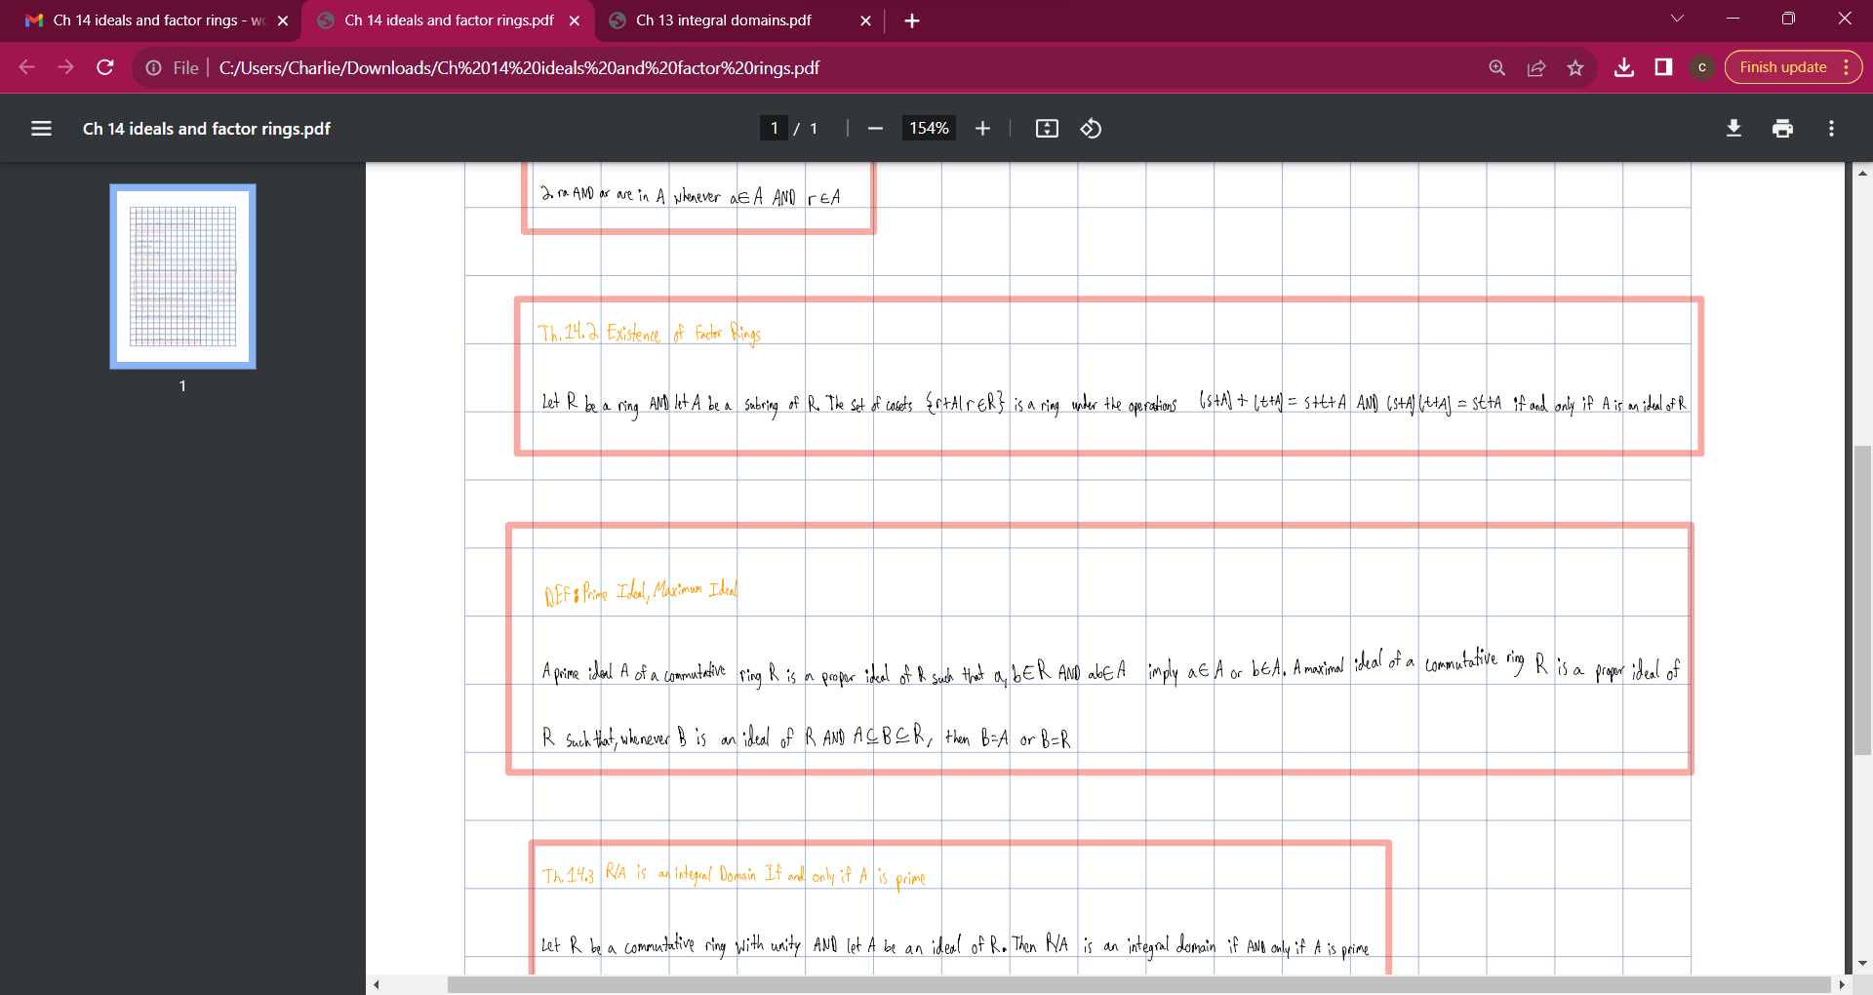

Slide 4
